Slide 1

INNOVATIVE
PROJECT
Real-Time Detection, Classification and Speed Estimation of Vehicles
By
Chaitanya Anand - 12021002002015
Arkadeepto Majumder - 12021002002092

Slide 2
About The Project
Introduction
The project develops a real-time system using deep learning to track, classify and estimate the speed of vehicles present in a video format data. Through convolutional neural networks and object detection, the model analyzes video footage to detect and track vehicles. It aims to enhance traffic management, surveillance, and decision-making, contributing to improved road safety and transportation efficiency.

Slide 3
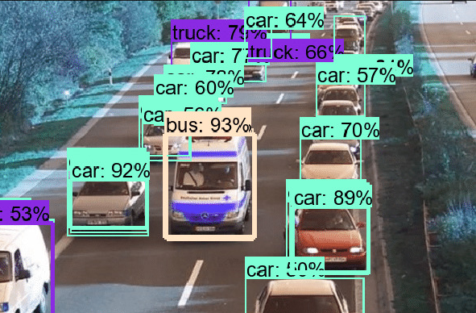
About The Strategy
Objectives
Primary Objectives:
Detection of each vehicle individually
Classifying the vehicles in common automobile classes
Calculating the approximate speed of each vehicle
Secondary Objective:
Detect whether a vehicle is responsible for obstructing the flow of traffic

Slide 4
Why?
Motivations
Primary Motivations:
Vehicle speed detection can be used to detect traffic jams and congestions
Vehicles entering or exiting the premises can be detected and their information can be shared with the property owners/ security
The required information for advanced traffic management systems can be reduced by using this system to obtain systematic data
Secondary Motivations:
Detect whether a vehicle is responsible for obstructing the flow of traffic

Slide 5

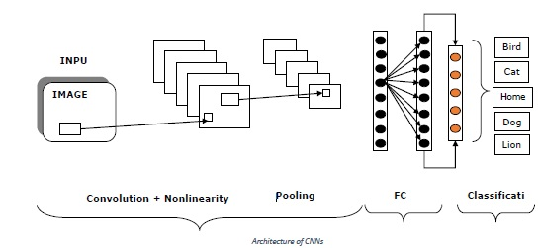
How we plan to proceed
Methodology
Dataset Collection and Preprocessing: A comprehensive dataset of vehicles are collected from popular databases such as Kaggle, COCO dataset. This dataset includes images and videos captured from various sources, such as traffic surveillance cameras and publicly available transportation footage.
Model Architecture Design: A deep learning model architecture is designed to detect and track the vehicles moving in the raw footage. Here, we use the YOLO detection algorithm since it has predefined PASCAL classes to classify vehicles. .

Slide 6
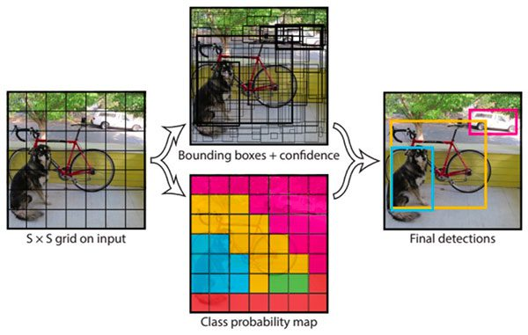
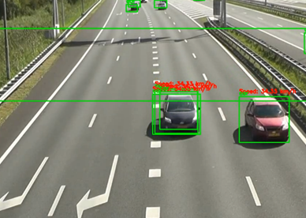
How we plan to proceed
Object Detection and Classification : The model trained on YOLO algorithm can detect and track the objects in real time footage in efficient manner since YOLO is a one-pass algorithm. Also, predefined PASCAL classes are used to classify the vehicles. The optimized weights used for training is saved for future uses.
Vehicle Speed Estimation: Using simple operations and elementary modifications to the frames in videos, vehicle speed is estimated by calculating the time taken by the vehicle to pass two externally drawn parallel lines and estimating the distance between them.

Slide 7
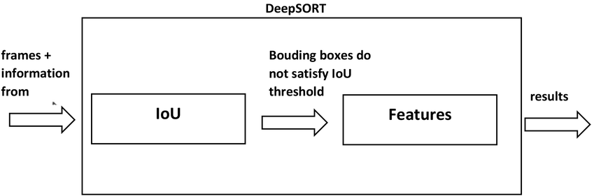
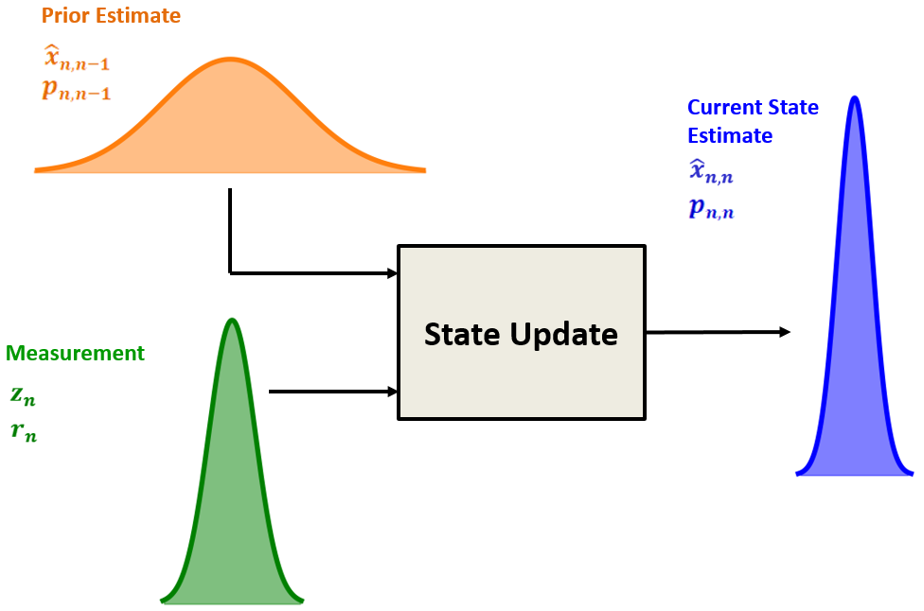
Methodology
Object Tracking: DeepSORT algorithm assigns a unique identifier to each vehicle throughout the sequence of video frames, allowing for the tracking of individual vehicles as they move across the frame.
Kalman Filter: It predicts the new state (position and velocity) of the object based on its previously estimated state which each new input and after each detection that has been associated with a track,

Slide 8
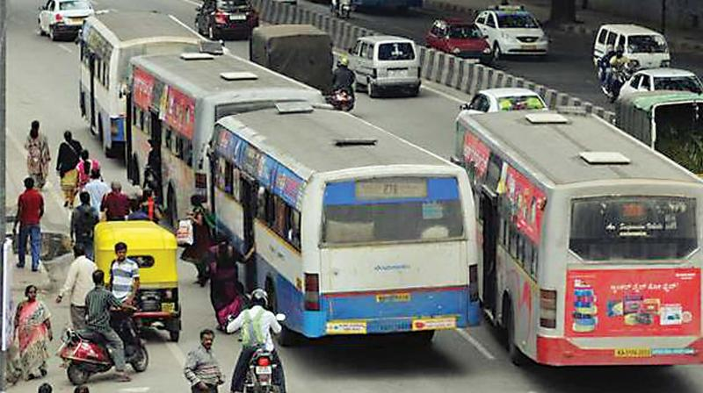
Methodology
How do we plan to detect if a slow moving vehicle is causing congestion?
Velocity of Buses: Determine the speed of buses by analyzing their movement across frames. A significant drop in speed compared to vehicles in earlier time frames may indicated congestion.
Surrounding Vehicle Density: Analyze the density of traffic near the bus. High vehicle density with slow movement can signal a traffic jam.

Slide 9
Things to be wary of
Challenges
Limited dataset: Obtaining diverse and annotated data of vehicles from high definition cameras is a difficult task.
Complex scenarios: Accurately identifying vehicles in crowded scenes with occlusions and varying scales.
Environmental factors also pose a challenge in obtaining clear footage.
01
02
03
Real-time processing: Efficient algorithms for timely identification and speed estimation without compromising performance.
Deployment and integration: Consideration of compatibility, scalability, and system integration with existing infrastructure and surveillance systems.
04
Notes:
Limited Dataset: Acquiring a diverse and representative dataset of slow-moving buses and number plates can be challenging. Obtaining a sufficient amount of annotated data that covers various lighting conditions, angles, and environmental factors is crucial for training a robust model.
Bus Detection in Complex Scenes: Identifying slow-moving buses in crowded and dynamic traffic scenarios can be challenging. The model needs to be trained to accurately distinguish buses from other vehicles, pedestrians, and objects, even in challenging conditions such as occlusions and varying scales.
Number Plate Extraction Accuracy: Precise extraction of number plates from bus images or video frames is essential for accurate recognition. Challenges such as variations in plate size, distortions, reflections, and noise can affect the extraction process and potentially lead to incorrect or incomplete results.
OCR and Number Plate Recognition: Achieving high accuracy in recognizing characters on number plates can be challenging due to variations in fonts, styles, and image quality. Dealing with skewed or partially obscured characters, as well as different languages or alphanumeric patterns, requires robust OCR techniques.
Real-Time Processing: Implementing the system for real-time processing of video footage poses additional challenges. Efficient algorithms and optimizations are required to ensure timely identification and number plate capture without compromising performance.
Deployment and Integration: Integrating the DeepBus system into existing infrastructure or surveillance systems can be complex. Compatibility, scalability, and system integration with cameras, networks, and backend processing need to be carefully considered.

Slide 10
About The Strategy
Future Prospects:
Improved Accuracy:
By leveraging against larger amount of data, the accuracy of Deep Learning Models can be drastically improved, especially by using data targeted towards the desired test requirements.
Real-time Processing:
By increasing the performance of hardware used, such as GPUs, the processing time of models can decrease, especially Object Detection Models through real-time videos making it more robust.
Multi-modal Recognition:
Deep learning algorithms can be trained to recognize license plates in a variety of conditions, including different lighting and weather conditions, and from different angles. This could enable the development of more robust license plate recognition systems.

Slide 11
Ending thoughts
Conclusion
In conclusion, the project offers a powerful solution for real-time detection, tracking and classification of vehicles in a video footage.
By incorporating the weights on the pre trained YOLO algorithm model, we managed to achieve an accuracy in the range of 85 - 89% and an average precision of 78%. The speed estimated falls within the accepted rate of error but it can be improved upon through additional techniques.
The project's success holds great potential for enhancing road safety, optimizing traffic flow, and improving overall transportation efficiency. With further advancements and integration, the project can make significant contributions to intelligent transportation systems and pave the way for smarter and safer cities.

Slide 12
THANK YOU

